Slide 1
1. Heart Disease Diagnostic Analysis
Comprehensive Study Using Heart Disease Dataset, and Leveraging Data to Improve Predictive Patient Outcomes.
The primary objective of this dataset is to facilitate the analysis and prediction of heart disease by leveraging various medical attributes. It supports clinical decision-making by helping that assist healthcare professionals in diagnosing heart disease, enabling early detection and improved treatment outcomes.
2. Analyzing Amazon Sales data
This dataset includes detailed sales records from Amazon, featuring information on product categories, sales volume, and pricing. The analysis aims to uncover insights and trends in Amazon's sales performance, identify key factors influencing sales, and provide actionable recommendations for optimizing future e-commerce strategies.

Slide 2
Introduction
In the span of one month, I successfully completed two significant projects, 1st Heart Disease Analysis and 2nd Amazon Sales Analysis. For the Heart Disease Analysis project, These methods were instrumental in analyzing and identifying patterns within the heart disease dataset. Throughout the project, resources like chatGPT , online tutorials, academic papers, and guidance from experts in the field were invaluable. Data preprocessing, feature selection, model training, and evaluation were meticulously executed to achieve the project's objectives. Similarly, for the Amazon Sales Analysis project, I utilized techniques such as data visualization and statistical analysis. Platforms like Google and YouTube provided invaluable resources, including tutorials and documentation, aiding in understanding complex statistical concepts and data visualization techniques. Through data analysis and statistical methods, insights into sales trends and influencing factors were extracted. These projects' results were obtained through diligent research, meticulous application of methodologies, and leveraging available resources effectively. This introduction sets the stage for detailed discussions on methodologies, findings, and conclusions in subsequent sections of the report.

Slide 3
Health is real wealth in the pandemic time we all realized the brute effects of covid-19 on all irrespective of any status. You are required to analyze this health and medical data for better future preparation.
1. Problem Statement
2. Problem Statement
Sales management has gained importance to meet increasing competition and the
need for improved methods of distribution to reduce cost and to increase profits. Sales
management today is the most important function in a commercial and business
enterprise.
Do ETL: Extract-Transform-Load some Amazon dataset and find for me
Sales-trend -> month-wise, year-wise, yearly month-wise
Find key metrics and factors and show the meaningful relationships between
attributes. Do your own research and come up with your findings.

Slide 4





Overview of KPI,s Metrics :
Indicates the count of total no. of people.
Indicates the no. of heart Disease people
Display the No-heart disease people
datasets.
Indicates the Heart Disease rate for people
Display the Average Age of People.

Slide 5
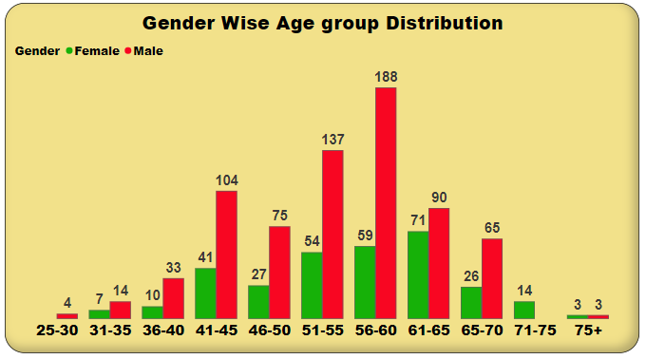
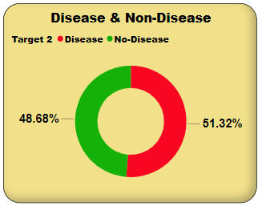
A notable increase in heart disease cases occurs in this age range, with males being significantly more affected.
Early Screening for Women:
The noticeable early onset in women aged 31-35 suggests the need for early screening and preventive measures in younger females.
Middle Age (41-60 Age Group): A notable increase in heart disease cases occurs in this age range, with males being significantly more affected.
Resource Allocation:
Healthcare resources should be efficiently allocated to address the peak incidence in the 51-60 age group, ensuring comprehensive care for the most affected demographics.
Awareness Programs:
Increased awareness and preventive initiatives are crucial for older populations, especially focusing on the declining but still significant incidence in the 61-75+ age range.
Disease Prevalence: 51.32% of individuals in the dataset have heart disease.
Non-Disease Group: 48.68% of individuals do not have heart disease.
Balanced Distribution: The near-equal distribution highlights a balanced dataset, providing a solid foundation for predictive analysis.

Slide 6
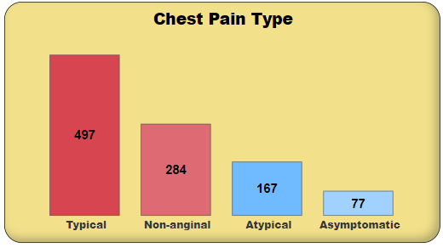
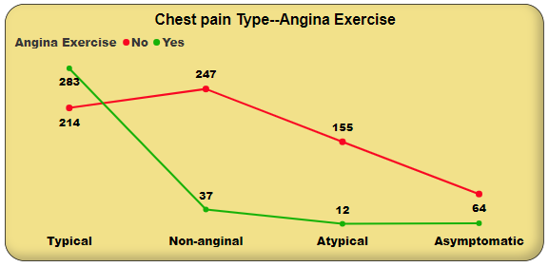
Chest Pain Type Distribution:
Typical Angina : Requires immediate cardiovascular assessment due to strong association with heart disease.
Non-anginal Pain : Needs further diagnostic testing to differentiate cardiac from non-cardiac causes.
Atypical Angina : Important to assess carefully due to potential underlying heart disease despite non-classic symptoms.
Asymptomatic : Regular screening and preventive strategies are recommended, especially for those with other risk factors, to identify silent heart disease.
Typical Chest Pain: The majority of individuals with typical chest pain experience angina during exercise, indicating a strong correlation between typical chest pain and exercise-induced angina.
Non-anginal Chest Pain: Most individuals with non-anginal chest pain do not experience angina during exercise. non-anginal chest pain is less likely to be associated with exercise-induced angina.
Atypical Chest Pain: Atypical chest pain is predominantly not associated with angina during exercise,
Asymptomatic: All asymptomatic individuals do not experience angina during exercise, indicating no link between being asymptomatic and having exercise-induced angina.

Slide 7
Conclusion
Age, Cholesterol, and Blood Pressure: Older age, higher levels of cholesterol, and elevated blood pressure emerged as strong predictors of heart disease. These factors indicate the importance of regular monitoring and management of cardiovascular health, particularly in older individuals.
Chest Pain Type and Angina: The type of chest pain experienced, particularly if it includes symptoms of angina, was significantly associated with the presence of heart disease. This highlights the importance of timely evaluation and intervention for individuals experiencing chest discomfort.
Diagnostic Parameters: Certain diagnostic parameters, such as the number of major vessels colored by fluoroscopy and specific types of thalassemia, provided valuable insights into the presence of heart disease. These parameters can aid in refining diagnostic strategies and treatment plans for patients at risk.
Preventive Measures: The findings underscore the importance of preventive measures such as lifestyle modifications, regular exercise, and dietary interventions to mitigate the risk of heart disease, especially in individuals with identified risk factors.
Clinical Implications: These conclusions have significant clinical implications, guiding healthcare professionals in risk assessment, early detection, and tailored interventions to reduce the burden of heart disease and improve patient outcomes.

Slide 8




Overview Of KPI’s Metrics:
Display the total no. of Sale
Display the total no. of Profit.
Indicates the Average of sales
Indicates the total Revenue.

Slide 9
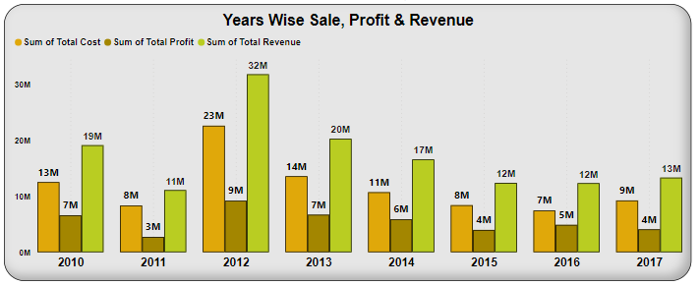
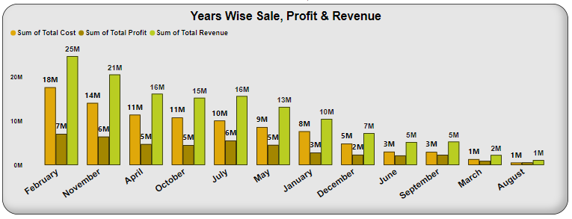
gf
2012 Peak: The year 2012 shows the highest performance with revenue , profit , and cost
Growth Trend (2010-2012): There is a clear upward trend in both revenue and profit from 2010 to 2012.
Drop in 2013: Revenue and profit drop significantly in 2013, with revenue at 14M and profit at 7M.
Stabilization (2014-2017): Revenue and profit stabilize from 2014 onwards:
2014 and 2015 have similar levels of revenue and profit.
2016 sees a rise in revenue and profit .
2017 shows a slight increase in revenue and profit compared to 2016.

Slide 10
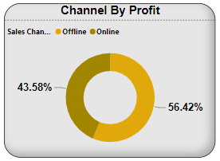
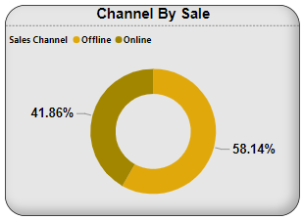
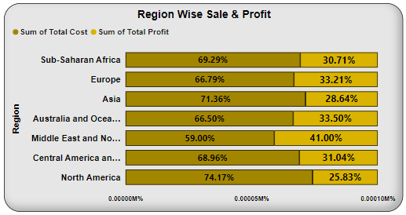
s
The data reveals a higher reliance on the online channel for both sales and profit, with online sales slightly outperforming offline in both metrics.
Businesses should consider investing more in their online presence and digital marketing strategies to maximize profit and sales.
Maintaining robust offline operations remains essential, as they still contribute significantly to both sales and profit.
A balanced approach that enhances online strategies while supporting offline channels will ensure comprehensive market coverage and optimized profitability.
These insights can guide strategic decision-making regarding resource allocation, marketing efforts, and sales strategies to effectively leverage both offline and online channels for overall business growth and profitability.
necessitating strategic interventions to reduce costs and enhance profit margins. Overall, these insights reveal varied regional performance, with the Middle East and North Africa leading in profitability and North America facing the most significant cost challenges. Strategic implications include focusing on cost management in high-cost regions like North America and Asia, while potentially replicating the successful models seen in the Middle East and North Africa to improve overall profitability.

Slide 11
Conclusion
Seasonal Trends and Demand: The analysis revealed distinct seasonal patterns in sales, with peak demand occurring during holiday seasons and promotional events like Black Friday and Cyber Monday. Understanding these fluctuations in consumer behavior is essential for effective inventory management and marketing strategies.
Product Performance and Customer Preferences: Certain products consistently outperformed others, indicating strong customer preferences and market demand. Identifying these high-performing products allows sellers to optimize their product offerings and capitalize on popular trends.
Price Sensitivity and Competitive Landscape: Price fluctuations and competitive pricing strategies significantly influenced sales volume and market share. Price sensitivity analysis highlighted the importance of competitive pricing while maintaining profitability. Additionally, monitoring competitors' pricing strategies enables sellers to stay competitive and maximize sales.
Customer Reviews and Satisfaction: Customer reviews and ratings played a crucial role in influencing purchasing decisions. Products with higher ratings and positive reviews tended to attract more customers and generate higher sales. Thus, prioritizing product quality and customer satisfaction is paramount for long-term success on the platform.
Marketing Effectiveness and Customer Engagement: The analysis also examined the impact of marketing campaigns and promotional activities on sales performance. Effective marketing initiatives, such as targeted advertising and promotional offers, were found to boost sales and enhance customer engagement. Understanding the effectiveness of various marketing channels allows sellers to allocate resources more efficiently and maximize ROI.

Slide 12
Thank You

